Slide 1
Majlis Ansārullāh
Monthly Meeting
September 2024
The Holy Quran and the Claim of Promised Messiah^{as}
This slide deck contains images licensed for the purpose of this presentation only.
No one is permitted to use the images for any other use, without prior permission.

Slide 2

Agenda
Recitation and translation of the Holy Quran
Pledge
Hadith
Discussion segment
Salat (Daily Prayers)
Al–Wasiyyat
Zahanat
Reading The Holy Quran
Health segment
Local Time – Missionary Comments/Reminders/Announcements
Du’a

Slide 3

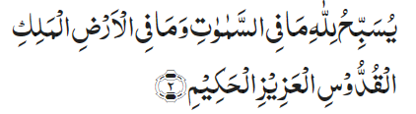
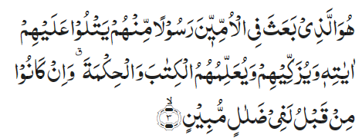


Recitation of the Holy Quran
In the name of Allah, the Gracious, the Merciful.
Whatever is in the heavens and whatever is in the earth glorifies Allah, the Sovereign, the Holy, the Mighty, the Wise.
He it is Who has raised among the Unlettered people a Messenger from among themselves who recites unto them His Signs, and purifies them, and teaches them the Book and wisdom, although they had been, before, in manifest misguidance;
And among others from among them who have not yet joined them. He is the Mighty, the Wise.
That is Allah’s grace; He bestows it on whom He pleases; and Allah is the Master of immense grace.
Chapter 62 Verses 1-4

Slide 4
Pledge
Say this part three times:
Ash-hadu • alla ilaha • illallahu • wahdahu • la sharika lahu • wa ash-hadu • anna Muhammadan • ‘abduhu • wa rasuluh
Say this part once:
I bear witness • that there is none worthy of worship • except Allah. • He is One • (and) has no partner, • and I bear witness • that Muhammad (peace be upon him) • is His servant • and messenger.
Say this part once:
I solemnly promise that • I shall endeavor • till the end of my life • for the consolidation • and propagation of Islām Ahmadiyyat • and for upholding • the institution of Khilafat. • I shall also be prepared • to offer the greatest sacrifice • for this cause. • Moreover, • I shall urge all my children • to remain true • to Khilafat Ahmadiyya. • Insha’Allah.

Slide 5

Hadith
O Allah, Bless Muhammad^{sa} and the people of Muhammad^{sa}, as Thou didst bless Abraham and the people of Abraham. Thou art indeed the Praiseworthy, the Glorious. Prosper, O Allah, Muhammad^{sa} and the people of Muhammad^{sa}, as Thou didst prosper Abraham and the people of Abraham. Thou are the Praiseworthy, the Glorious
Says Abu Hurairah^{ra}:
'One Day we were sitting with the Holy Prophet when Surah Jumu‘ah was revealed. I enquired from the Holy Prophet, Who are the people to whom the words, 'And among others of them who have not yet joined them,' refer.' Salman, the Persian, was sitting among us. Upon my repeatedly asking him the same question, the Holy Prophet put his hand on Salman and said, 'If Faith were to go up to the Pleiades, a man from these would, surely, find it’
(Bukhari)

Slide 6
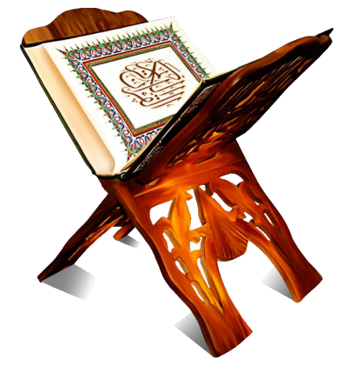
Discussion Segment
Suggested Time 15 mins

Slide 7
Recitation of the Holy Quran
In the name of Allah, the Gracious, the Merciful.
Whatever is in the heavens and whatever is in the earth glorifies Allah, the Sovereign, the Holy, the Mighty, the Wise.
He it is Who has raised among the Unlettered people a Messenger from among themselves who recites unto them His Signs, and purifies them, and teaches them the Book and wisdom, although they had been, before, in manifest misguidance;
And among others from among them who have not yet joined them. He is the Mighty, the Wise.
That is Allah’s grace; He bestows it on whom He pleases; and Allah is the Master of immense grace.
Chapter 62 Verses 1-4

Slide 8
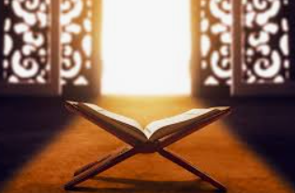
Understanding the verses
One Nasir learned how to use Twitter (X). He started defending Islam/Ahmadiyyat to the best of his ability. One of his contacts asked him to show that the coming of Mirza Ghulam Ahmad^{as} has been mentioned in the Holy Quran and he will accept Ahmadiyyat. The Nasir did a thorough search and could not find the name Ghulam Ahmad in the Holy Quran.
How would you help him proving the truth of the Promised Messiah^{as} from the Holy Quran?

Slide 9
Understanding the verses
62:4 – The verse signifies that, the Message of the Holy Prophet^{sa} was meant not only for the Arabs among whom he was raised but for all non-Arabs as well, and not only for his contemporaries but also for the generations to come till the end of time. Or, the verse may signify that the Holy Prophet will be raised among another people who have not yet joined his immediate followers. The reference in the verse and in a well-known saying of the Holy Prophet is to the Second Advent of the Holy Prophet himself in the person of the Promised Messiah in the Latter Days. Says Abu Hurairah^{ra}: 'One Day we were sitting with the Holy Prophet when Surah Jumu‘ah was revealed. I enquired from the Holy Prophet, Who are the people to whom the words, 'And among others of them who have not yet joined them,' refer.' Salman, the Persian, was sitting among us. Upon my repeatedly asking him the same question, the Holy Prophet put his hand on Salman and said, 'If Faith were to go up to the Pleiades, a man from these would, surely, find it' (Bukhari). This saying of the Holy Prophet shows that the verse applies to a man of Persian descent. The Promised Messiah, the Founder of the Ahmadiyya Movement, was of Persian descent. Other sayings of the Holy Prophet speak of the appearance of the Messiah at a time when there would remain nothing of the Qur’an but its words and of Islam but its name, i.e. the true spirit of Islamic teaching will have been lost (Baihaqi). Thus the Qur’an and the Hadith both agree that the present verse refers to the Second Advent of the Holy Prophet in the person of the Promised Messiah.
Five Volume Commentary Ref - 4236

Slide 10
Understanding the verses
The points made in Chapter 62 Verse 4 and the hadith provide a convincing mention of the Promised Messiah^{as} Mirza Ghulam Ahmad of Qadian (peace be on him)
The Holy Prophet^{sa} is talking about his second appearance
His second coming will be in distant future (faith ascending to Pleiades couldn’t possibly be in his time)
Despite presence of the Holy Quran and Ahadith, faith could disappear
The one who will bring it back will be a non-Arab and be of Persian descent. (This also means it will not be the Holy Prophet^{sa} himself)
Someone who can be considered as the second coming of the Holy Prophet^{sa} himself has to be completely subservient of the Holy Prophet^{sa} and a complete devotee of the Prophet^{sa}. In fact, he will be servant of Ahmad or Ghulam of Ahmad
The Promised Messiah^{as} fulfilled all these criteria. He is an ardent lover and complete devotee of the Holy Prophet Muhammad^{sa}; He is of Persian descent; He appeared when true Islamic teachings had practically disappeared. He was able to show the true face of Islam to the world and established a community that lives by true Islamic teachings

Slide 11


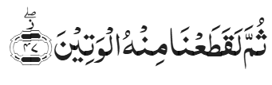

Understanding the verses
Chapter 69 Verses 45-48
And if he had forged and attributed any sayings to Us,
We would surely have seized him by the right hand,
And then surely We would have severed his life-artery,
And not one of you could have held Us off from him.
  These verses provide a clear proof of truth of the Promised Messiah^{as}
  Allah the Almighty is describing His practice of destroying someone who lies against Allah
  The Promised Messiah^{as} claimed to receive direct revelation from Allah the Almighty for decades. However, not only was he not destroyed by Allah, but his community also continues to spread despite all odds.

Slide 12
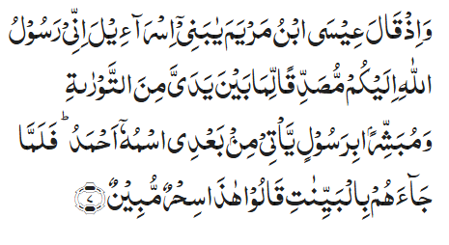
Understanding the verses
Chapter 61 Verse 7
And remember when Jesus, son of Mary, said, ‘O children of Israel, surely I am Allah’s Messenger unto you, fulfilling that which is before me of the Torah, and giving glad tidings of a Messenger who will come after me. His name will be Ahmad.’ And when he came to them with clear proofs, they said, ‘This is clear enchantment.’
  The prophecy mentioned in the verse under comment applies to the Holy Prophet, but as a corollary it may also apply to the Promised Messiah, Founder of the Ahmadiyya Movement, since in his person the Second Manifestation of the Holy Prophet took place. To this Second Manifestation or Second Coming of the Holy Prophet, the third verse of the next Surah—Al-Jumu‘ah pointedly refers.
  (Five Volume Commentary – Reference 3037)

Slide 13
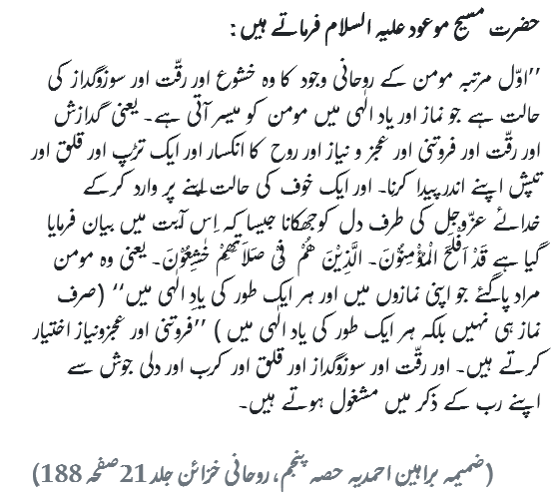
Salat
The Promised Messiah^{as} writes:
The first stage of a believer's spiritual state is that humility, weeping and tender-heartedness which a believer experiences during Salat and remembrance of Allah. That is, to generate in oneself a spirit of supplication, poignancy, humility, extreme humbleness, meekness of soul, ardor and warmth. To assume a state of fear while turning to the Glorious God as this verse states: 'Surely, success comes to the believers, Who are humble in their Prayers.' (23: 2-3). That is, successful are the believers who are humble in their Salat and during remembrance of Allah and who are engaged in remembrance of their Lord with poignancy, tender-heartedness, ardor and heart-felt passion.’
Appendix, Barahin e Ahmadiyya Part 5
Ruhani Khazain Volume 21, Page 188

Slide 14
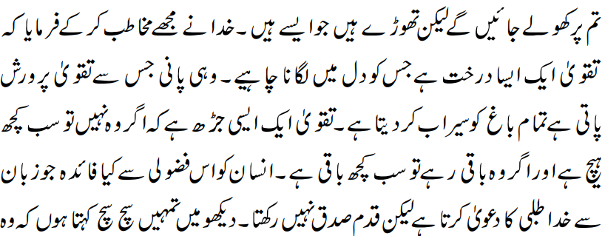
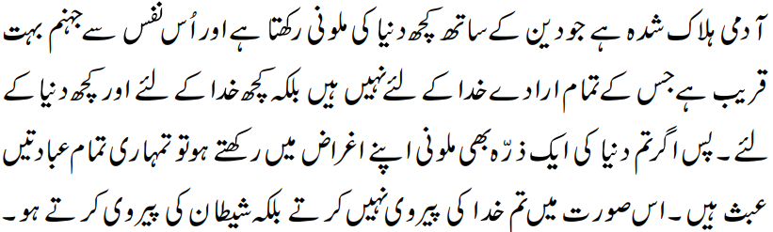
Al Wasiyyat
God addressed me and said that Taqwa is a tree that should be planted in the heart. The very water which nourishes Taqwa irrigates the whole garden. Taqwa is a root without which everything is meaningless; and if it remains intact then nothing is lost. What benefit is there for a man in indulging himself in the useless activity of claiming with his tongue that he seeks God while he has no sure footing with his Lord. Look, I say to you truly and sincerely that ruined is he whose faith is tainted by even a hint of worldliness. Hell is very close to that soul all of whose intentions are not for God – rather some of them are for God and others are for the world. Thus, if you have an iota of worldly adulteration in your intentions, all your worship is in vain.

Slide 15
Zahanat
In what year did World War II end?
  1941
  1945
  1948
  1950
Whose face is on a US $5 bill?
  George Washington
  Benjamin Franklin
  Abraham Lincoln
  Thomas Jefferson
In which country is the Sphinx located?
  Greece
  India
  Egypt
  Mexico

Slide 16
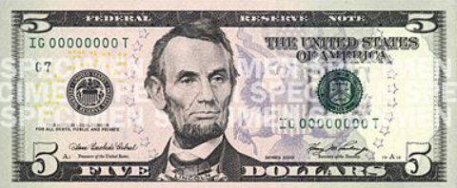
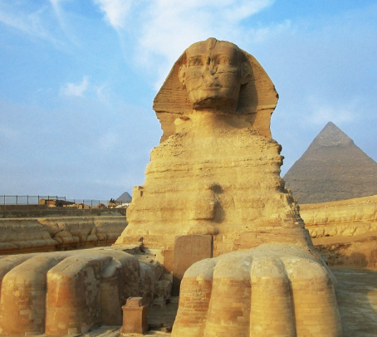
Zahanat
In what year did World War II end?
  1941
  1945
  1948
  1950
On May 8, 1945, Germany surrendered. After the atomic bomb was dropped on Hiroshima and Nagasaki, Japan surrendered on September 2, 1945, and the Second World War came to an end.
Reference – Library of Congress
Whose face is on a US $5 bill?
  George Washington
  Benjamin Franklin
  Abraham Lincoln
  Thomas Jefferson
In which country is the Sphinx located?
  Greece
  India
  Egypt
  Mexico
The Great Sphinx of Giza is a limestone statue of a reclining sphinx, a mythical creature with the head of a human and the body of a lion. Facing directly from west to east, it stands on the Giza Plateau on the west bank of the Nile in Giza, Egypt. The face of the Sphinx appears to represent the pharaoh Khafre. It is known as أبو الهول‎‎ in Urdu.

Slide 17
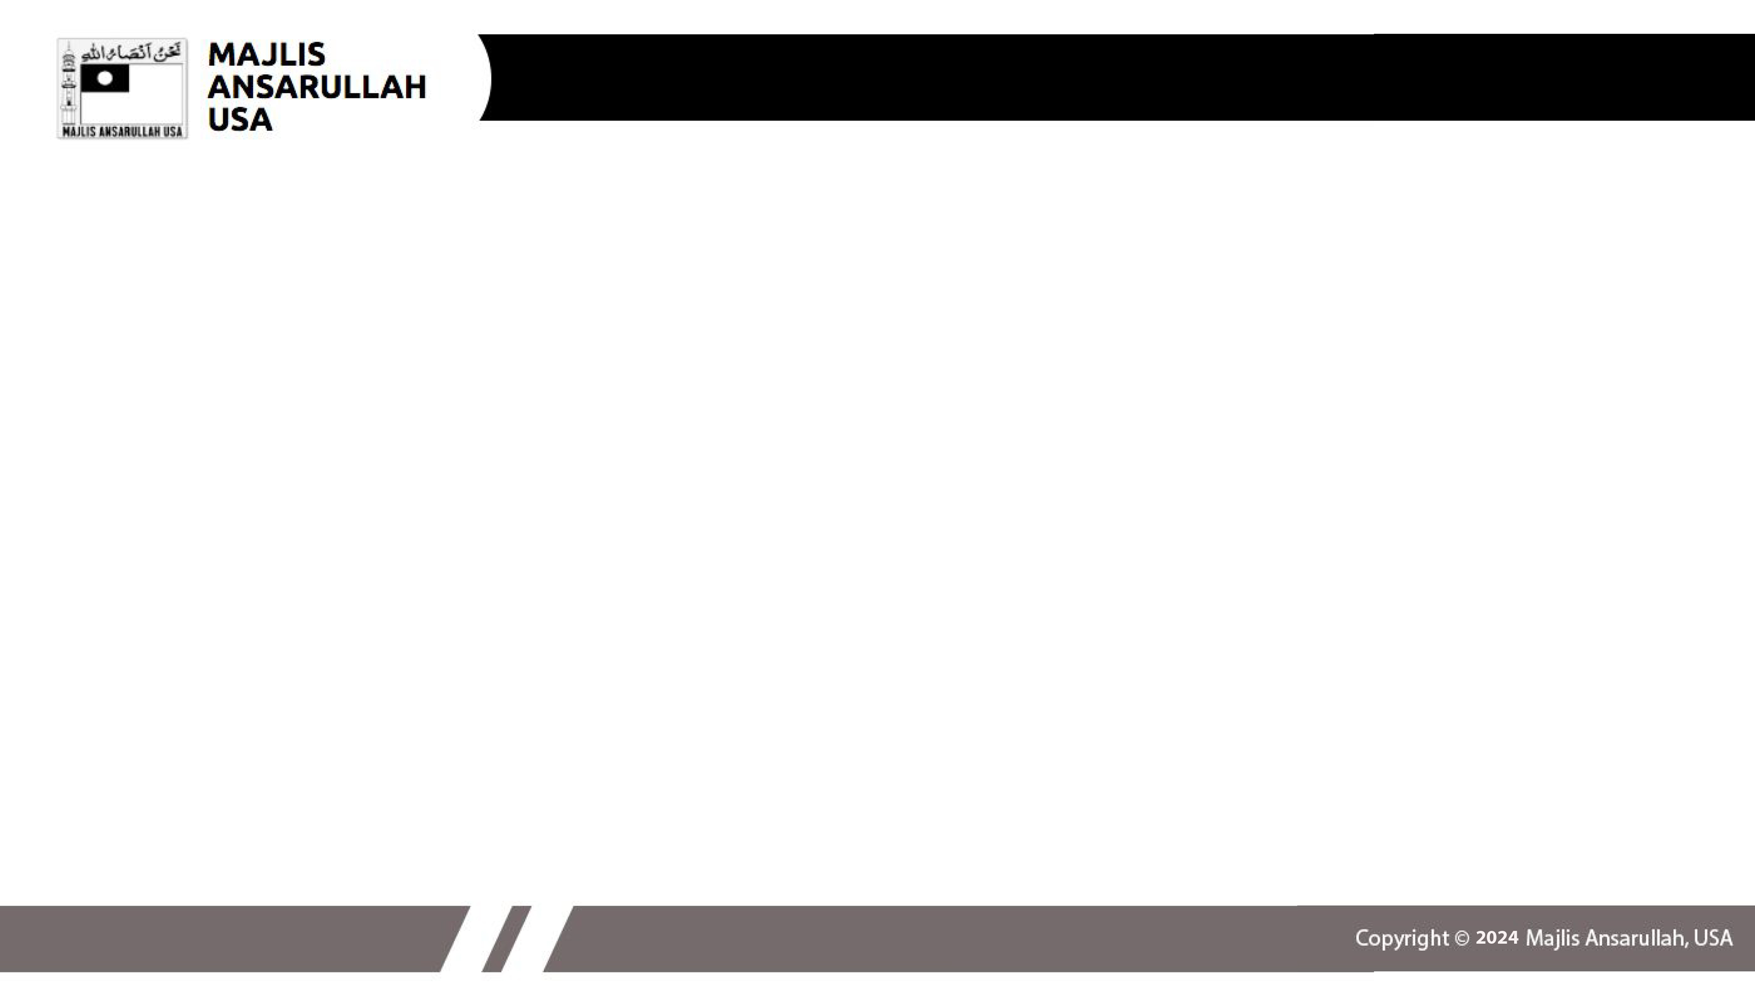


Reading The Holy Quran
Quran Tajweed Basics
Rules of Waqf(Stop)
Waqf means to pause or stop. During the recitation of Quran, if one needs to stop at the end of meaningful sentence with break of breath or at the end of verse, these rules apply on the stopping word;
In Continuation
In Pause
Change to
Note: Letters with Fat’ha, Dammah, Kasra, Tanween and vertical kasra/inverse Dammah are changed to letters with sukoon

Slide 18


Reading The Holy Quran
Quran Tajweed Basics
Rules of Waqf(Stop) Cont.
In Continuation
In Pause
Note: the change(or no change) in red in the last letter of the word at Waqf
Change to

Slide 19
Health

Slide 20
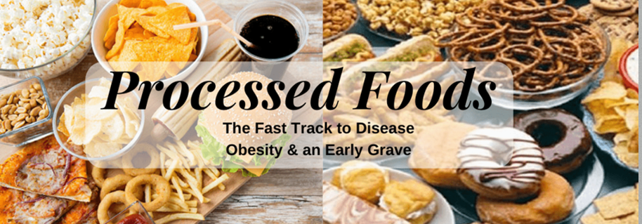
Ultra-processed foods
Tanvir Ahmed

Slide 21
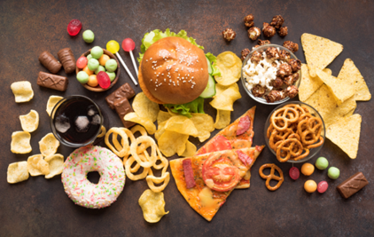
ultra processed foods
Ultra-processed foods are produced with industrial ingredients and often food additives to adjust color, flavor, consistency, texture, or to extend shelf life
There are about 5,000 substances that get added to our food. Most of them have never been tested for safety and health risks by anyone other than the company using them
Ultra-processed foods include prepackaged soups, sauces, frozen pizza and ready-to-eat meals, hot dogs, sausages, French fries, sodas, store-bought cookies, cakes, candies, doughnuts, ice cream etc.
Heavily processed foods often include unhealthy levels of added sugar, sodium and fat

Slide 22
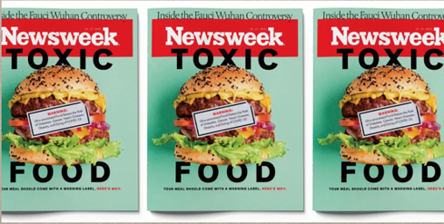
ultra processed foods
Some researchers think that ultra-processed foods increase inflammation because they are recognized by the body as foreign – much like an invading bacteria. The more inflammation, the more the risk of many diseases of bowel, heart, joints etc.
People who eat more of these foods also tend to drink more fizzy drinks and less tea and coffee and also less vegetable, and fruits. They are more likely to be physically inactive, eat more calories
It could be the combined ill affect of both ultra-processed foods and lack of healthy diet

Slide 23
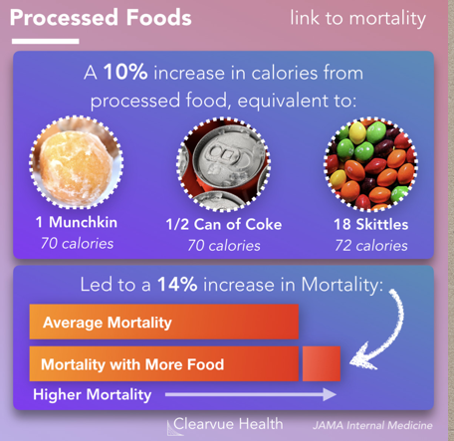
ultra processed foods
Eating more ultra processed foods raises the risk of developing and dying from cancer, especially ovarian cancer
The risk of dying from any cancer increased by 6%, while the risk of dying from ovarian cancer rose by 30%, depending on how much ultra processed food was consumed
Ultra-processed foods is linked to increased risk of obesity, heart attacks, stroke, diabetes mellitus and kidney disease.

Slide 24

Eating healthy
People who are too busy to take care of their health will soon find themselves busy taking care of their illness
Eat natural and minimally processed foods, made at home
Your children respond to what you do and say - lead by example
For any questions, please contact qaid.health@ansarusua.org

Slide 25
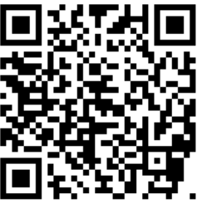
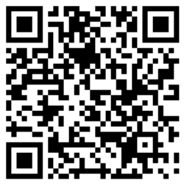
Local Majlis Time
Sign-up for TAQWA Quran classes via the following link
https://www.altaqwa.us/registration/
Sign-up for Waqf e Ardhi via the following link
https://tinyurl.com/WaqfeArdhiSignup
Murabbi Sahib’s Comments
Reminders/announcements
Du’a
Adjourn
Waqf e Ardhi Sign-up
Jazakumullah for Participating!
If you enjoyed it, please convey to those brothers who are not here today!
Please take a moment to provide your feedback
https://tinyurl.com/TalimDeckFeedback
Feedback

