Slide 1
Majlis Ansārullāh
Monthly Meeting
December 2021
This slide deck contains images licensed for the purpose of this presentation only.
No one is permitted to use the images for any other use, without prior permission.

Slide 2
Agenda
Recitation of the Holy Quran
Pledge
Salat page
The Holy Quran segment (10 min)
      - Selected verses
      - Questions and comments
Friday Sermon segment (20 min)
-Sermon synopsis
-Discussion scenario and guidance from sermon
-Take home message
Mental and physical health segment (15 min)
Open slot for local topics
Reminders/announcements
Dua

Slide 3
Recitation of the Holy Quran
O Prophet! when believing women come to thee, taking the oath of allegiance at thy hands that they will not associate anything with Allah, and that they will not steal, and will not commit adultery, nor kill their children, nor bring forth a scandalous charge which they themselves have deliberately forged, nor disobey thee in what is right, then accept their allegiance and ask Allah to forgive them. Verily, Allah is Most Forgiving, Merciful. (60:13)

Slide 4
Ansar Pledge
Say this part three times:
Ash-hadu • alla ilaha • illallahu • wahdahu • la sharika lahu • wa ash-hadu • anna Muhammadan • ‘abduhu • wa rasuluh
Say this part once:
I bear witness • that there is none worthy of worship • except Allah. • He is One • (and) has no partner, • and I bear witness • that Muhammad (peace be upon him) • is His servant • and messenger.
Say this part once:
I solemnly pledge • that I shall endeavor • throughout my life • for the propagation • and consolidation • of Ahmadiyyat in Islam, • and shall stand guard • in defense of • the institution of Khilafat. • I shall not hesitate • to offer any sacrifice • in this regard. • Moreover, • I shall exhort my children • to always remain dedicated • and devoted • to Khilafat. • Insha’allah.

Slide 5
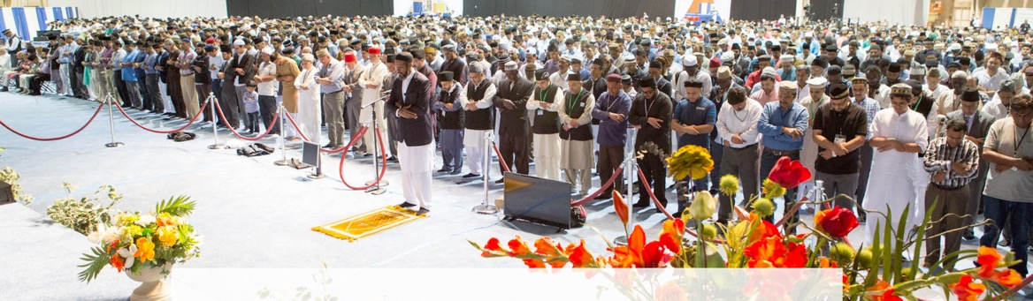
Salat Page
Salat is an instrument for security against sins. It is a characteristic feature of Salat that it drives one away from sin and evil deeds. Therefore, seek that sort of Salat and try to mold your Salats accordingly. Salat is the essence of blessings. Favors of Allah are attained through the Salat. Therefore, perform it decently that you may inherit Allah’s blessings.
(Malfuzat Vol. 3 p 103)

Slide 6
The Holy Quran Segment
Suggested Time = 10 mins
It contains verses, questions
about the verses followed
by commentary

Slide 7
Recitation of the Holy Quran
O Prophet! when believing women come to thee, taking the oath of allegiance at thy hands that they will not associate anything with Allah, and that they will not steal, and will not commit adultery, nor kill their children, nor bring forth a scandalous charge which they themselves have deliberately forged, nor disobey thee in what is right, then accept their allegiance and ask Allah to forgive them. Verily, Allah is Most Forgiving, Merciful. (60:13)

Slide 8
Questions
What is your understanding of a Ma’ruf decision?

Slide 9
Commentary
The meaning of these words are clear in that it means to establish the commands of God Almighty and to advise the community to adhere to these instructions. Therefore, it is incumbent upon every individual who considers themselves as part of this Jamaat to abide by this pledge and obey every instruction issued by the Khalifa accordingly.
Hazrat Musleh Maud^{(ra)} has also explained this issue by saying that should there ever be a scenario whereby a wrong instruction has been issued, then since God Almighty Himself is to safeguard the institution of Khilafat, He will never permit the outcome of that decision to be harmful. Instead, God Almighty will create those circumstances by which there will be a positive outcome from that instruction. (Tafsir-e-Kabir, Vol. 6, pp. 376-377, under the verse Surah al-Nur: 56)
Therefore, it is not the job of an individual to interpret what is a ma‘ruf decision. A ma‘ruf decision is one which is in line with the Quran, the practice of the Holy Prophet^{(sa)} his sayings and also that which falls in line with the just arbitrator [Hazrat Mirza Ghulam Ahmad^{(as)} of this era.

Slide 10
Friday Sermon Segment
Suggested Time = 20 mins
It contains the following items:
Synopsis of Friday Sermon (2 slides)
Scenario discussion and discussion questions (2 slides)
Guidance from Sermon to close the discussion (1 slide)
Take home message from the Sermon (1 slide)

Slide 11
Bond of brotherhood with the Promised messiah (peace be on him)
Friday Sermon Fazal Mosque, London: September 19, 2003
Friday Sermon

Slide 12
That he/she shall enter into a bond of brotherhood with this humble servant of God, pledging obedience to me in everything good for the sake of God, and remain faithful to it until the day of his/ her death. That he/she shall exert such a high devotion in the observance of this bond as is not to be found in any other worldly relationship and connection that demand devoted dutifulness.
Tenth condition of Bai’at

Slide 13
Synopsis of the Sermon
But the relationship of love and brotherhood that is being established means much more than that. You are not merely establishing a bond of equals; instead, you are acknowledging that it is a command of Allah and His Messenger (pbuh) to accept the Messiah that was promised. Therefore, you are establishing this bond for the sake of Allah the Almighty.
Here it must be understood that this, instead, is the bond of a slave and servant. Indeed, it should be even more than that. You have to be obedient without any grumbling.
When you have taken the bai‘at and have entered the organization of the Jama‘at of the Promised Messiah (peace be on him), you have given everything of yours’s to the Promised Messiah (peace be on him). Since the system of Khilafat exists after him, you have to follow the decisions and the instructions of the Khalifah of the time.
In this tenth condition of Bai‘at, the Promised Messiah (peace be on him) has placed great emphasis on having such a strong bond with him that there should be nothing like it in any other relationship of this world. The only reason for this emphasis is, strictly speaking, his sympathy for us. Because the true Islam can be found only and only by accepting him, if we want to save ourselves from drowning, then we have to get on the ark of the Promised Messiah (peace be on him).

Slide 14
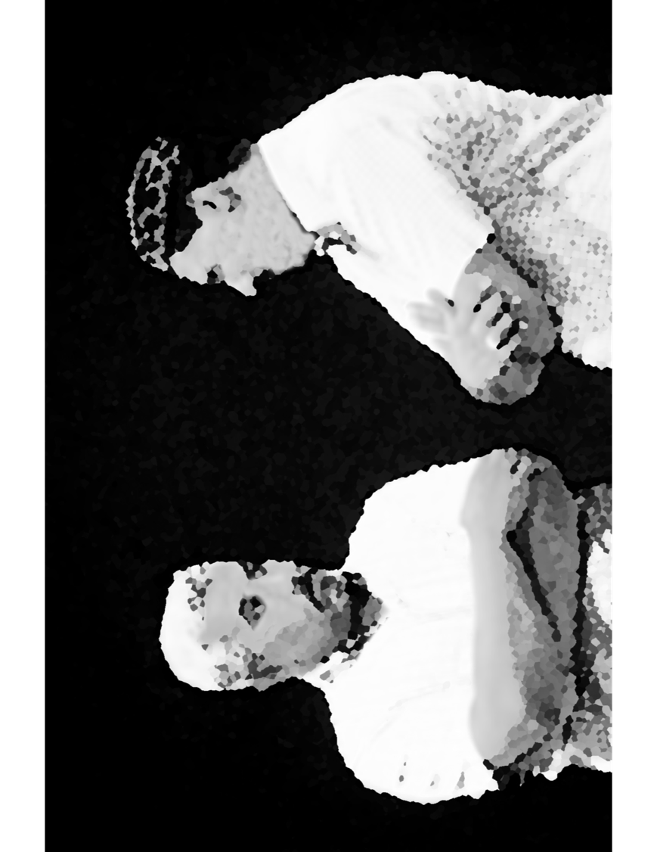
Discussion Scenario
After Ansar monthly meeting, Zai’m sahib asked members if Zuhr/Asr Salat be combined or should they offer Zuhr only. Nasir ‘A’ suggested to combine as days are getting shorter. Nasir ‘B’ got upset and said Salat should be offered on time and separately.
Pointing to Nasir ‘A’ he said that you probably don’t even offer Salat on time at home and now you are asking for disrupting our Salat. Nasir ‘A’ got very upset and a loud argument erupted in the Masjid.

Slide 15
Discussion
In your opinion, who was responsible for this unfortunate incident. Nasir ‘A’, Nasir ‘B’ or the Za’im?
How could this have been avoided?
What quality was missing in the two Nasirs?
Any other observations?

Slide 16
Guidance from the Sermon
“Evil also develops from direct confrontations, fights and abuses. That also creates discord. The Promised Messiah (peace be on him) tells us: if you are connected to me and you claim submission to me, then shun everything of mischief and evil. You should have such patience and tolerance that even if someone abuses you, you should show restraint. The door of salvation will open for you when you act upon this teaching. You will join those who have achieved nearness to Allah. There should be no confrontation in any matter. Even being in the right, be humble like one who is in the wrong. No matter what the other person has said, deal with that person with love, affection and sincerity. Your tongue should be so pure, your language so sweet, and good morals so overflowing that people should be attracted towards you. Everyone should realize that you are an Ahmadi. Nothing less than the highest moral values can be expected of you. In short, your high morals will attract others and will become a source for drawing their attention”.
Bottom line is that, In this case both Nasir brothers lacked patience and tolerance. They could easily have figured this out without an argument.

Slide 17
Take "home" message?
Pick one of the following topics from this Friday sermon to discuss with children/family during casual discussion:
  As a family, discuss how can we assess our love of the Promised Messiah (peace be on him).
  Review all ten conditions of Bai’at and pledge that you and your family will do level best to abide by all of them.
Tips to engage youth in conversation: (1) Give them more talking time, and (2) use examples from Huzur’s (may Allah be his helper) sermon to make a point.

Slide 18
Mental and Physical health Segment
Suggested Time = 15 mins
It contains questions of
general knowledge and/or
religious knowledge
followed by their answers.
A thought-provoking video and a physical health segment

Slide 19
Mental Health

Slide 20
Quiz
Why does the sky appear blue?
How much sleep is recommended for different age groups (sleepfoundation.org) ?
Who was Baba Nanak?

Slide 21
1. Sunlight reaches Earth's atmosphere and is scattered in all directions by all the gases and particles in the air. Blue light is scattered more than the other colors because it travels as shorter, smaller waves. This is why we see a blue sky most of the time. Interestingly sky is orange reddish on Mars (nasa.gov)
2.
Answers
Age Range | Recommended Hours of Sleep
Newborn | 0-3 months old | 14-17 hours
Infant | 4-11 months old | 12-15 hours
Toddler | 1-2 years old | 11-14 hours
Preschool | 3-5 years old | 10-13 hours
School-age | 6-13 years old | 9-11 hours
Teen | 14-17 years old | 8-10 hours
Young Adult | 18-25 years old | 7-9 hours
Adult | 26-64 years old | 7-9 hours
Older Adult | 65 or more years old | 7-8 hours

Slide 22
3. In 1895 Huzoor^{(as)} made known the outcome of his research regarding the religious beliefs of Founder of the Sikh religion. Huzoor^{(as)} stated that although Hadhrat Baba Nanak was born in a Hindu household, he had later on accepted Islam. Hadhrat Baba Nanak (1469-1539) was a righteous person who meticulously followed all the teachings of Islam, so much so that he traveled to Mecca for the purpose of performing pilgrimage to the House of Allah. One of his holy gowns contained Islamic declaration of faith, as well as many verses of the Holy Quran inscribed in Arabic.
Answers

Slide 23

Quality work takes time
From Tips & Tricks

Slide 24
Physical Health

Slide 25
DO NOT IGNORE THESE SIGNS & SYMPTOMS
1. Unexplained weight loss
If you are not obese and you have lost more than 10 pounds or more than 5% of your body weight unintentionally, in the last 6-12 months consult your doctor. Many common or serious diseases may be the cause (hyperthyroidism), diabetes, depression, liver disease, cancer etc.
2. Persistent or High Fever
Fever is a common symptom and it's not always a cause of alarm. However, persistent fever may be due to more serious underlying illness. Seek care with your doctor

Slide 26
DO NOT IGNORE THESE SIGNS & SYMPTOMS
3. Shortness of Breath
A new onset of shortness of breath or worsening shortness of breath may signal serious underlying illness. The list is exhaustive and diverse and requires professional medical attention
4. Unexplained changes in Bowel Habit Or Change in Appetite
An unexplained change in your bowel habits or appetite and weight changes from your normal is a cause for concern and requires investigations. Things to consider are infections, inflammation, irritable bowel syndrome or even cancer. Seek care early do not delay. Know your family history

Slide 27
DO NOT IGNORE THESE SIGNS & SYMPTOMS
5. A change in Personality
A gradual or sudden change in personality merits attention. It may be as simple as medication side effects or more serious underlying psychological and medical conditions. Many are easily treatable
6. Save your Vision
Changes in vision, flashing lights, or eye pain, always requires urgent attention. Immediate attention save your vision from serious illnesses like Retinal Detachment, Glaucoma etc.

Slide 28
Open Segment
Suggested Time = Zaim’s discretion
Zaim can include any other segment of local interest in this segment

Slide 29
That’s all folks
Reminders/Announcements
Dua
Jazakumullah for Participating!
If you enjoyed it, please convey to those brothers who are not here today!

